Slide 1
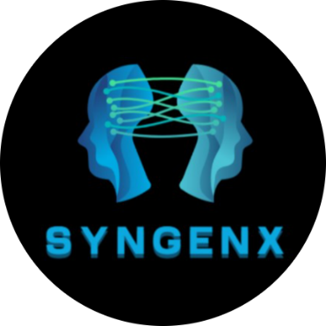
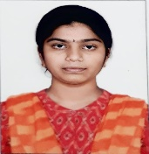
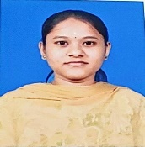


GENERATING REALISTIC SYNTHETIC DATA FOR ML
Author 1
Photo
Author 2
Photo
Author 3
Photo
Author 4
Photo
KARUNASAGARI S D
KAVIYA R
NAVEEN RAJ K
YOGHANAARAYANAN A
SRM TRP ENGINEERING COLLEGE
TIRCHIRAPPALLI
MS JEYAMEDONA P (AP/CSE)

Slide 2
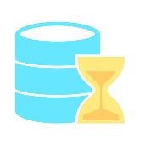

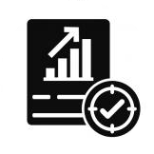
GENERATING REALISTIC SYNTHETIC DATA FOR ML
CHALLENCE
Data Scarcity
Limited availability of real-world data makes it challenging to train machine learning models effectively.
Privacy Concerns
Using real data risks exposing sensitive information, especially in regulated industries like healthcare and finance.
Statistical Accuracy
Generating synthetic data that maintains the complex relationships and statistical properties of real data is difficult.

Slide 3
APPROACH
Data Scarcity
Generate synthetic data using TVAEs and SAGANs to fill gaps in real data.
Privacy Concerns
Use differential privacy to protect sensitive information in the generated data.
Statistical Accuracy
Validate synthetic data with real-time checks to ensure it matches real data patterns.

Slide 4
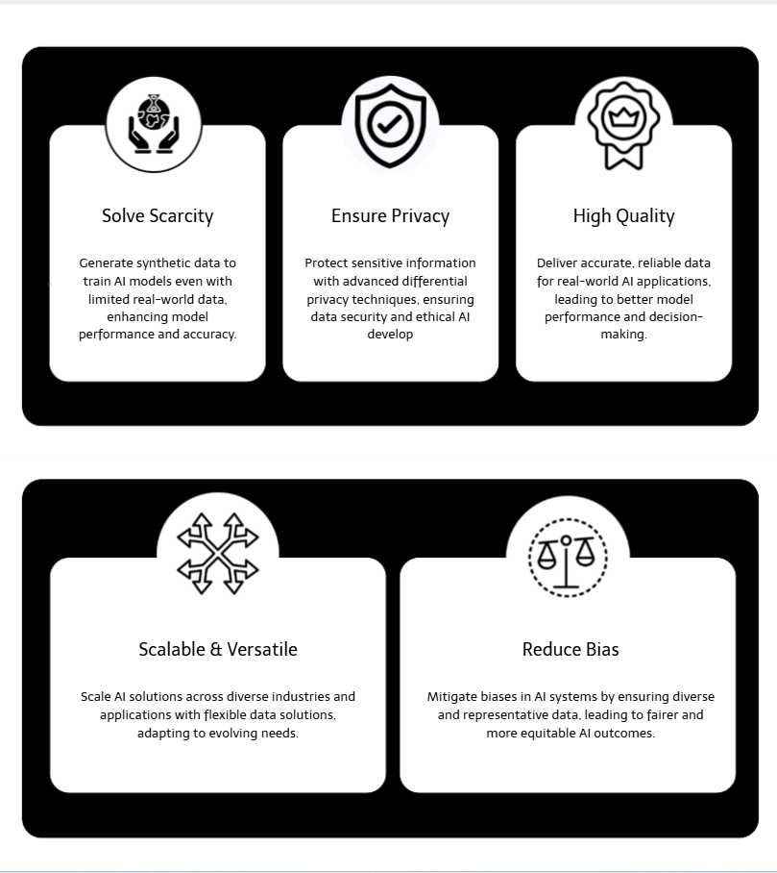
VALUE PROPOSITION
PROS
Solves data scarcity by generating realistic synthetic data.
Protects privacy with differential privacy techniques.
Ensures statistical accuracy for reliable ML model training.
CONS
Requires advanced AI expertise for implementation.
High computational cost for training models.
Quality depends on the real data used for training.

Slide 5
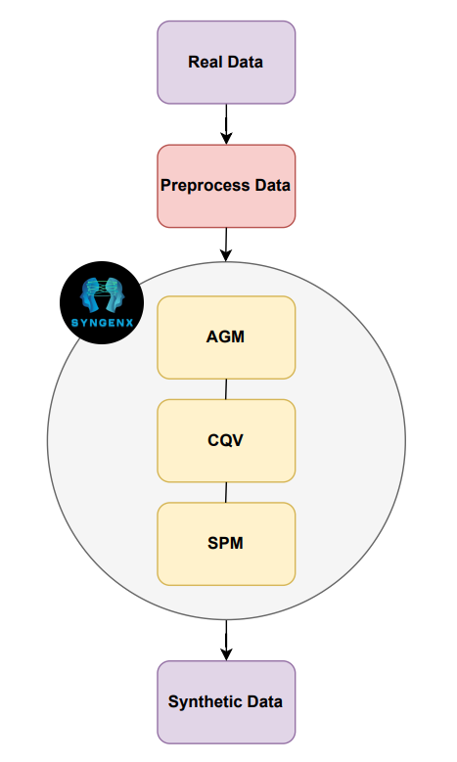
TECHNICAL STACK
WORKFLOW
Technical Stack
Programming | Python
Frameworks | TensorFlow, PyTorch
Synthetic Data Tools | SDV, scikit-learn
Privacy Tools | TensorFlow Privacy, PySyft
Infrastructure | AWS/Google Cloud, Docker, Kubernetes
Visualization | Matplotlib, Seaborn
Validation | SciPy, MLFlow

Slide 6
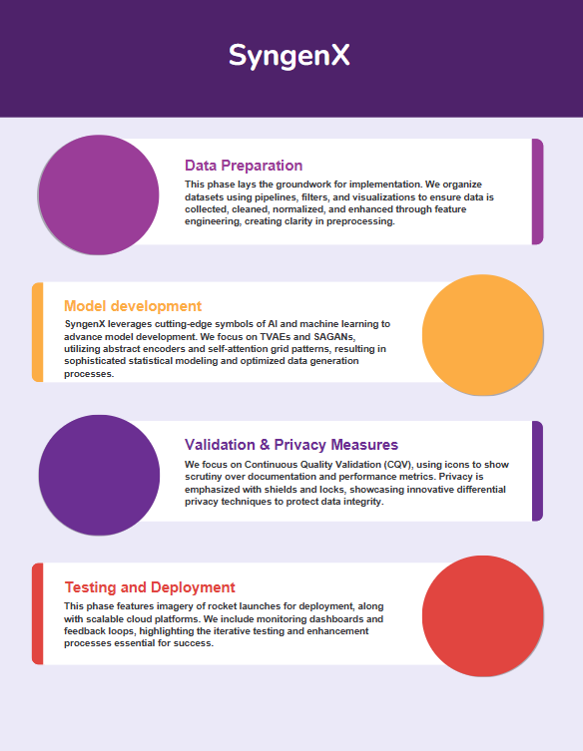
IMPLEMENTATION PLAN

Slide 7
Import Libraries
(Sdv, diffprivlib)
EXECUTION FLOW
Upload Dataset
(Data.csv)
Preprocess Data
Generate Metadata
Train TVAE
Merge GAN And TVAE Data
Validate Data(KS Test)
Apply Differential Privacy
Execution Drive Link
Download Synthetic Data
(synthetic_data.csv)
https://drive.google.com/file/d/1v3GuY_DR-HywatYUxn0sRx0_qSLCHy1b/view?usp=sharing
CSV Drive Link
https://drive.google.com/file/d/1dakfoFQmEFj6ULkRWVOakt_XpCF5CFWf/view?usp=drivesdk

Slide 8
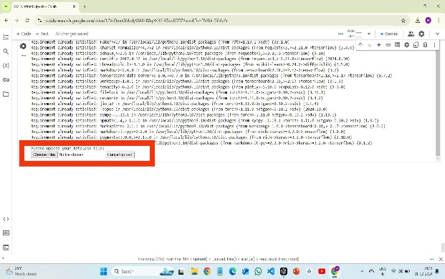
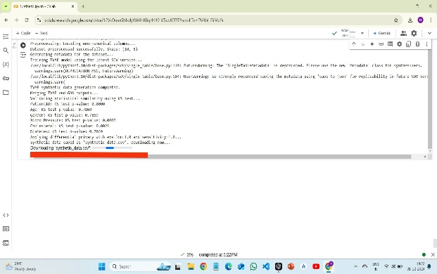
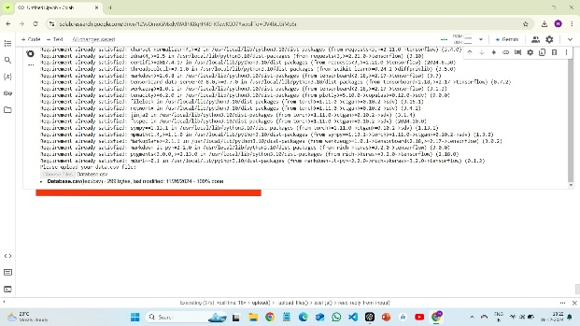
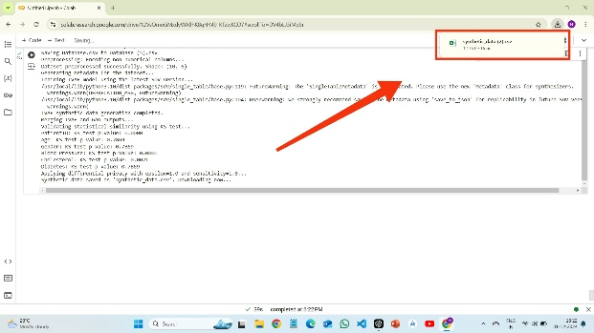
VALIDATION
(1) Data Upload Process
(3) Synthetic Data Generation Process
(2) Real Data Uploaded
(4) Synthetic Data - Download Confirmation

Slide 9
ESTIMATION
Development Costs
Data Scientists & Engineers | ₹4,150–₹12,450/hour
Team of 4 (3–6 months) | ₹83,00,000–₹1,66,00,000
Infrastructure Costs
Cloud Computing (GPU) | ₹4,15,000–₹12,45,000/month
6 months | ₹25,00,000–₹75,00,000
Data Management Systems | ₹4,15,000–₹8,30,000
Licensing and Software
Proprietary Tools | ₹8,30,000–₹16,60,000
Validation and Testing
Quality Assurance | ₹16,60,000–₹33,20,000
Operational Costs
Maintenance and Scaling | ₹8,30,000–₹16,60,000 annually
Miscellaneous Costs
Legal Compliance | ₹8,30,000–₹12,45,000
Training | ₹8,30,000–₹12,45,000
Initial Development Phase | ₹1,50,00,000–₹3,12,00,000.
Annual Ongoing Costs | ₹16,60,000–₹41,50,000
COST ESTIMATE

Slide 10
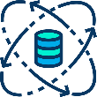


ASSUMPTIONS
Availability of Real Data
Sufficient real-world data is available for training the models.
Computational Resources: Adequate hardware or cloud infrastructure (e.g., GPUs) is available for model training.
Privacy Compliance
Differential privacy techniques will effectively safeguard sensitive data and comply with regulations like GDPR and HIPAA.
User Expertise
The team implementing and managing the system has the required expertise in AI, machine learning, and privacy techniques.

Slide 11
CONCLUSION
SynGenX provides a robust solution for generating high-quality, privacy-compliant synthetic data. It addresses data scarcity, ensures statistical accuracy, and protects privacy using advanced AI models like TVAEs and SAGANs. Despite the need for expertise and resources, it offers significant value for scalable and reliable AI-driven innovation.
REFERENCES
Kingma & Welling (2014) on Variational Autoencoders, Zhang et al. (2019) on Self-Attention GANs, and Patki et al. (2016) on Synthetic Data Vault.Abadi et al. (2016) on Deep Learning with Differential Privacy, TensorFlow Privacy GitHub.

Slide 12
THANK YOU!

